Slide 1
Chapter 23: Phyla Chordata

Slide 2
Phylum Chordata
The name Chordata comes from the notochord; a rodlike, semirigid tissue enclosed in a sheath.
The chordates have five basic characteristics: 1) dorsal, tubular nerve cord overlying
2) a supportive notochord
3) pharyngeal slits
4) an endostyle for filter feeding,
5) a postanal tail for propulsion.

Slide 3
Phylum Chordata
In most cases, the notochord extends the length of the body and is between the gut tract and the nervous system.
The notochord mainly serves to stiffen the body or act as a skeletal axis.
Chordates share features with some invertebrates: bilateral symmetry, anterioposterior axis, coelom, tube-within-a-tube body plan, metamerism (segmentation) and cephalization.
However, the evolutionary position of Chordates is uncertain.

Slide 4
Phylum Chordata
Earlier theories were based on a relationship with the protostome branch; this is considered unlikely.
The important common features are: radial cleavage, anus derived from the blastopore, mouth derived from a secondary opening, and a coelom formed by fusion of enterocoelous pouches.

Slide 5
Five Chordate Hallmarks
A. Notochord
1. This feature as well as the other four is always found at some embryonic stage of all chordates.
2. The notochord is the first part of the endoskeleton to appear in the embryo.
3. It serves as an axis for muscle attachment; it can bend without shortening and permits undulation.

Slide 6
A. Notochord (continued)
4. In vertebrates, a series of cartilaginous or bony vertebrae form from mesenchymal cells derived from blocks of mesodermal cells lateral to the notochord.

Slide 7
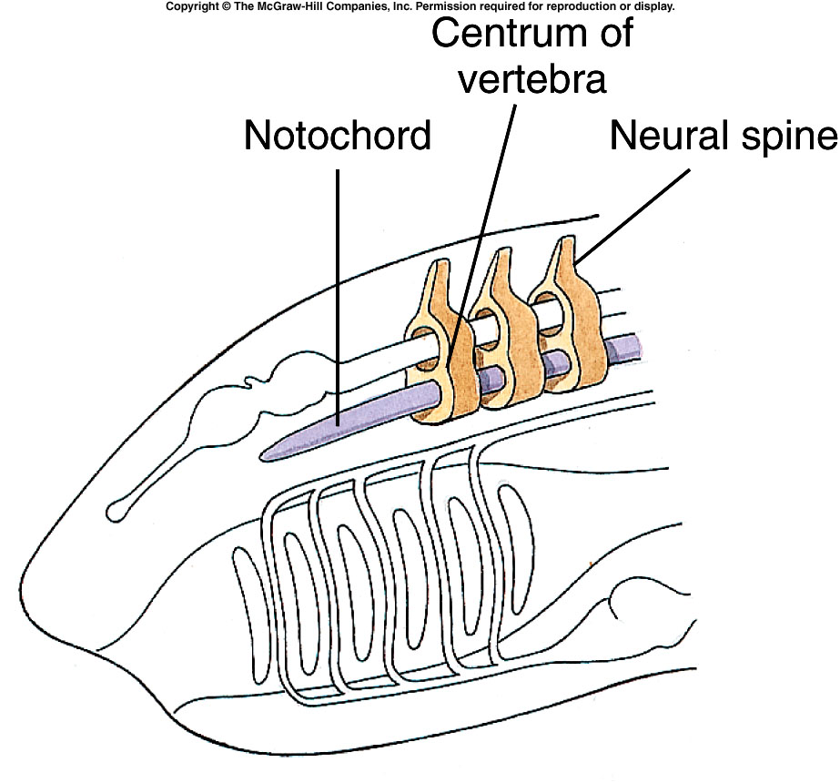
Living Endoskeleton
Allows growth without molting
Allows larger size

Slide 8
B. Dorsal Tubular Nerve Cord
1. In most invertebrate phyla, the nerve cord is ventral to the alimentary canal and solid.
2. In chordates, the single cord is dorsal to the alimentary canal and is tubular.
3. The anterior end enlarges to form the brain.
4. The cord is produced by the infolding of ectodermal cells on the dorsal side of the body.

Slide 9
B. Dorsal Tubular Nerve Cord
5. Lies just dorsal to notochord, usually extends anteriorly in the form of a brain.
6. This is the central nervous system
7. Allows sensory perception, complex movement, etc.
8. Extremely important to success of chordates.

Slide 10
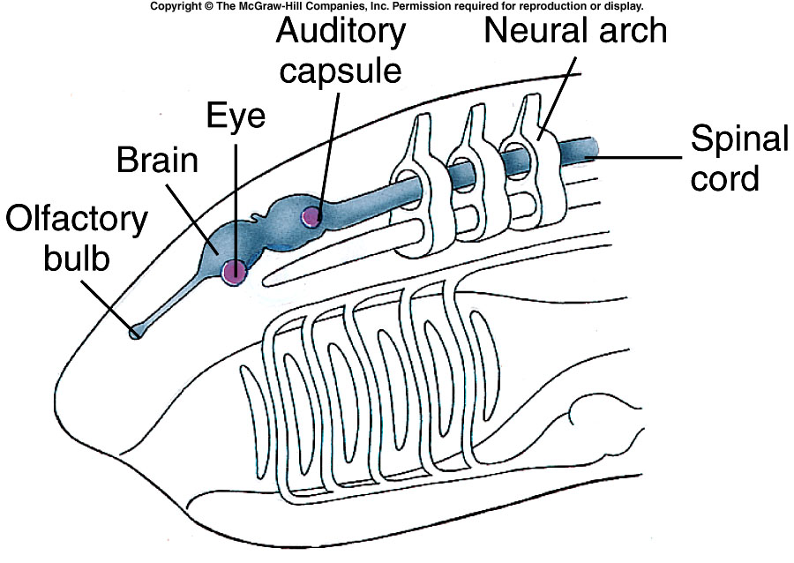
Advanced Nervous System in Subphylum Vertebrata
Expanded nerve cord into a tripartite brain (3 parts, fore,mid,and hind brain) and sensory structures.
Develop paired eyes and ears, chemoreceptors, pressure sensors, and olfactory sensors

Slide 11
C. Pharyngeal Pouches and Slits
1. Pharyngeal slits lead from the pharyngeal cavity to the outside.
2. They form by the inpocketing of the outside ectoderm and the evagination of the pharynx endoderm.
3. In aquatic chordates, the two pockets break through to form the pharyngeal slit.

Slide 12
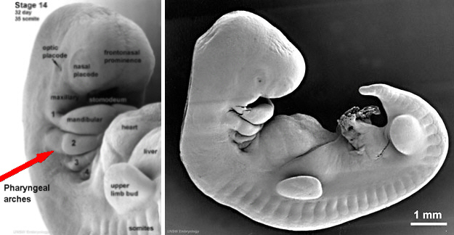
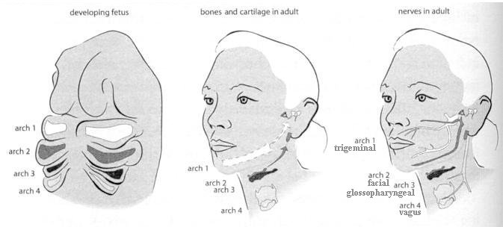

Slide 13
C. Pharyngeal Pouches and Slits
4. In tetrapods,(four- footed vertebrates) the pharyngeal pouches give rise to a variety of structures, including the Eustachian tube, middle ear cavity, tonsils and parathyroid glands.
5. Openings between digestive tract and outside of body.
6. Used for filter feeding in some. Others have gills in slits, used for respiration.
7. Pharyngeal slits of terrestrial vertebrates are only found in embryonic stages.

Slide 14
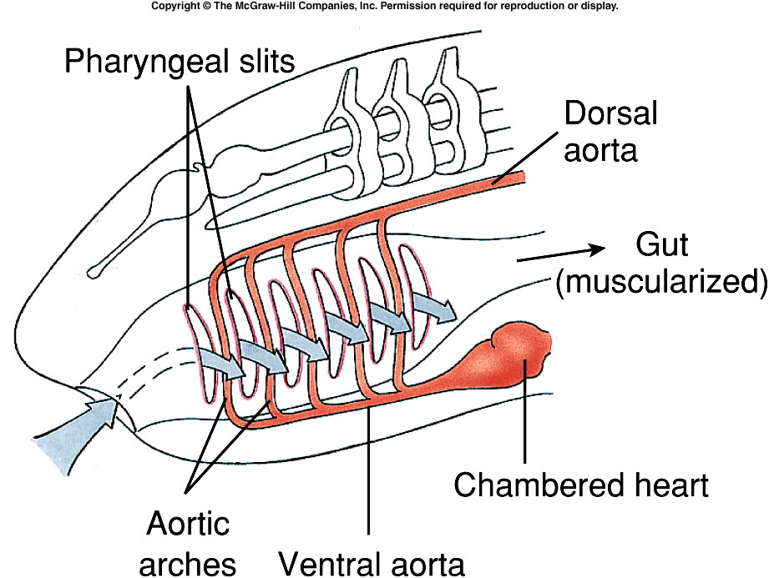
Pharynx and Respiration
First used for filter feeding, later predatory feeding.
Addition of heart and capillary beds increased circulation.
Allows higher metabolic rate.

Slide 15
D. Endostyle or Thyroid Gland
1. Recently, the endostyle was recognized as a shared chordate character.
2. The endostyle or its derivative, the thyroid gland, is found in all chordates.
3. Located in the pharyngeal floor, it secretes mucus that traps small food particles in the pharyngeal cavity.
4. Some cells in the endostyle secrete iodinated proteins homologous with the iodinated-hormone-secreting thyroid gland of adult lampreys and the remainder of vertebrates.

Slide 16
E. Postanal Tail
1. The postanal tail, plus musculature, provided motility for larval tunicates and Amphioxus to swim.
2. This was increased in fishes with the addition of fins but became smaller or vestigial in later lineages.
Humans have only a vestige ( the coccyx, a series of small vertebrae at the end of the spinal column).

Slide 17
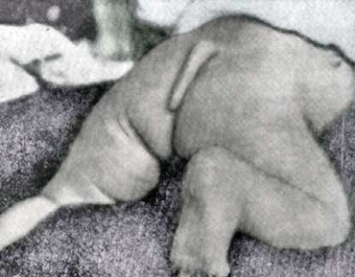
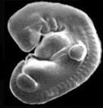
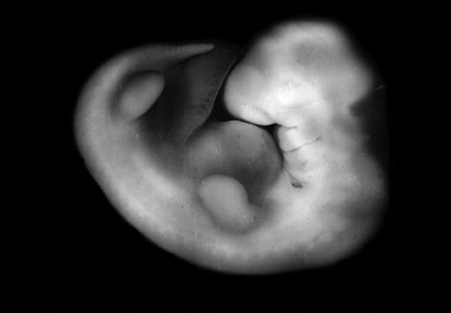
Human embryo

Slide 18
Ancestry and Evolution
A. History
1. The earliest protochordates were soft-bodied and would not have left many fossils.
2. Most work has been conducted on early developmental stages where early features are conserved.
3. A theory that chordates evolved within the protostome lineage was discarded due to embryo evidence.

Slide 19
A. History (continued)
4. The deuterostomes are a natural grouping that has a common origin in Precambrian seas.
5. Anatomical, developmental, and molecular evidence indicate that chordates arose about 570 million years ago from a lineage related to echinoderms and hemichordates.
6. Some workers suggest that Hemichordata is the sister group to Chordata; others suggest that the chordate ancestry lies with an extinct free-swimming echinoderm.

Slide 21
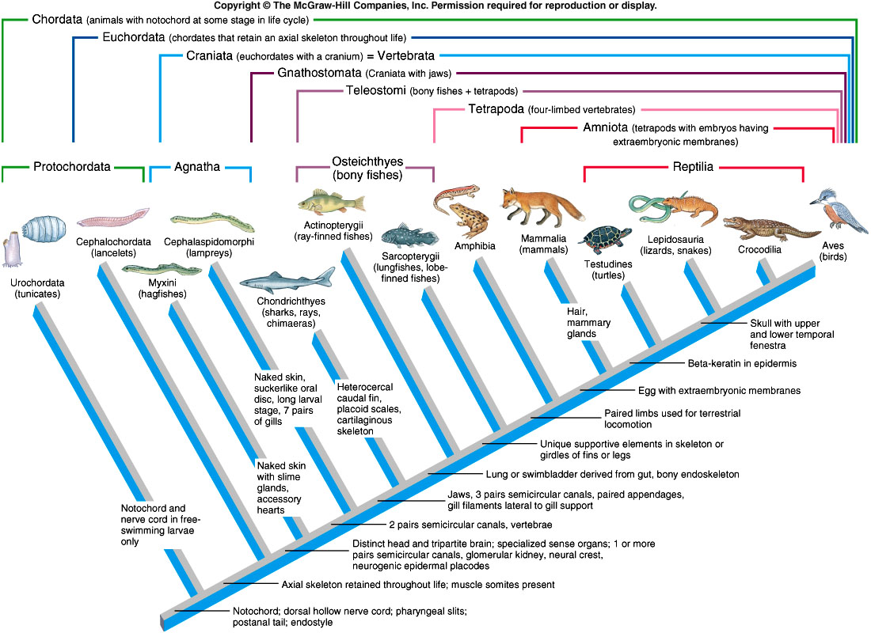

Slide 22
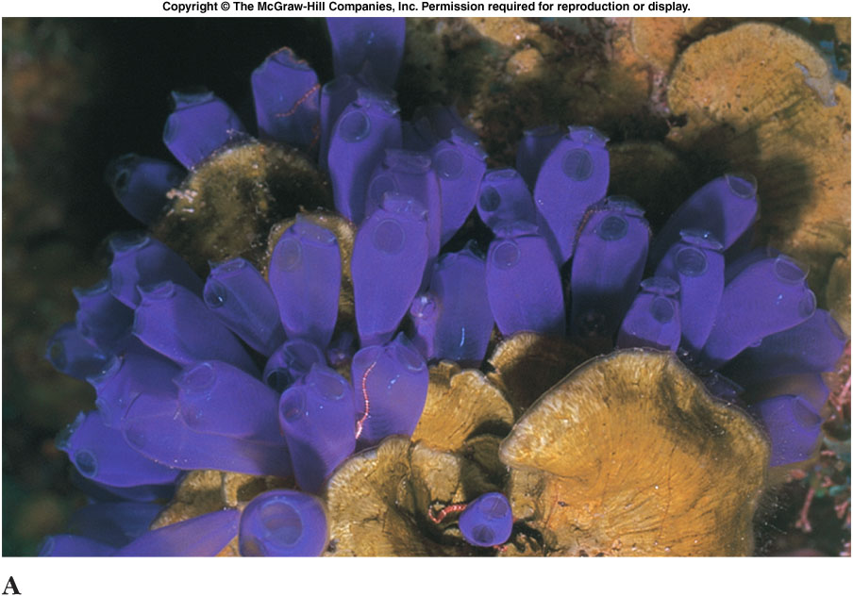
Subphylum Urochordata
Tunicates or Sea Squirt
Marine invertebrates
Notochord, nerve cord, and postanal tail only found in larval stage
Adult stage sessile

Slide 23
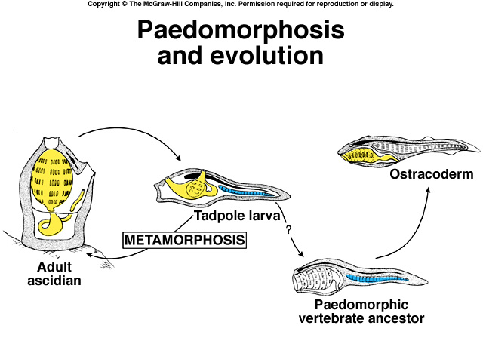

Slide 24
Subphylum Cephalochordata
Lancelets
Marine invertebrates
Clearly show all five chordate characteristics
Includes Branchiostoma (Amphioxus)
Tadpole-like filter feeders
Postanal
Tail

Slide 25
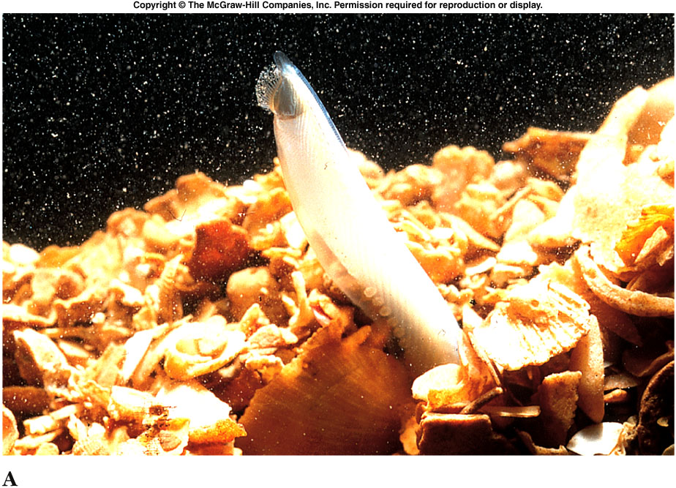

Slide 26
Adaptations toward Vertebrate Evolution
Living endoskeleton
Pharynx and efficient respiration
Advanced nervous system
Paired limbs
Generally two pairs, first for swimming and later for land.

Slide 27
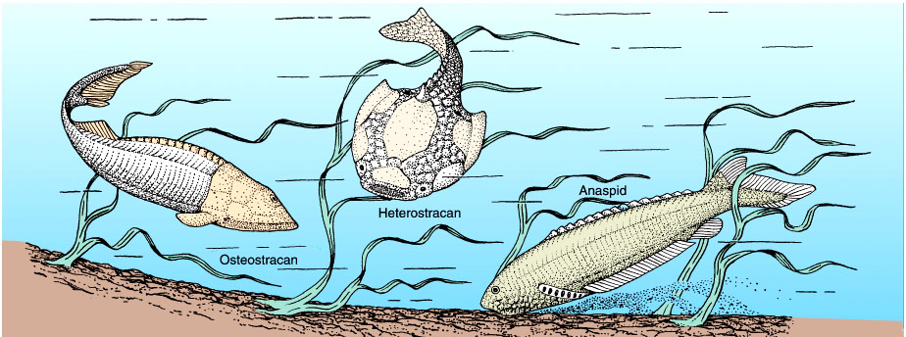
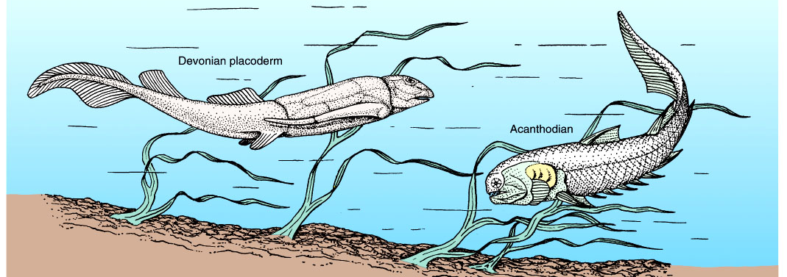
Early Vertebrates

Slide 28
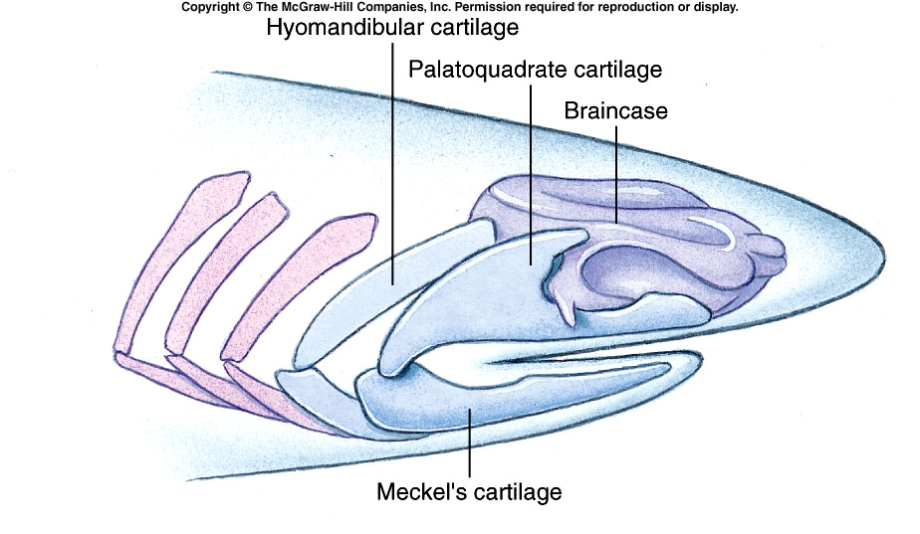
Evolution of Jaws

